Slide 1
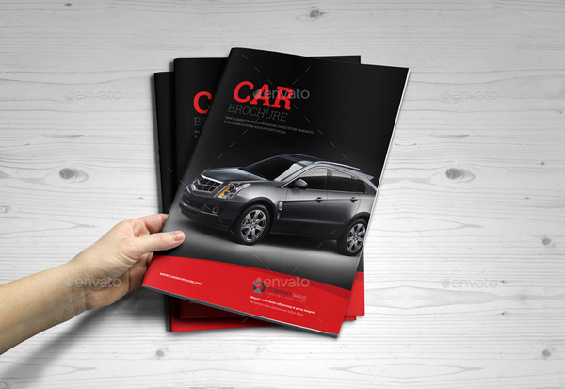
CAR CATALOG
Project Members : Rohan Kulkarni, Aditee Verma & MIlind Ikke
Guided by: Prof: Llesh Miraj

Slide 2
Motivation
Create car catalog for customers to get an easy access to choose from a wide range of cars

Slide 3
Technologies Used
Web technologies: HTML, CSS, JavaScript, PHP
Database: MySQL
Server: Apache

Slide 4
Our website will have the following features
Search a new car | Browse through the catalog (Customer Roles)
Insert | Delete | Update (Admin roles)

Slide 5
User Roles
A new user will create an account and login into the website
A customer can browse through the catalog and search for a new car
Customer can choose from a number of cars which are present in the database

Slide 6
Admin Roles
Admin can update the catalog
He can also insert new cars into the catalog
Delete the sold cars or ones which are not available

Slide 7
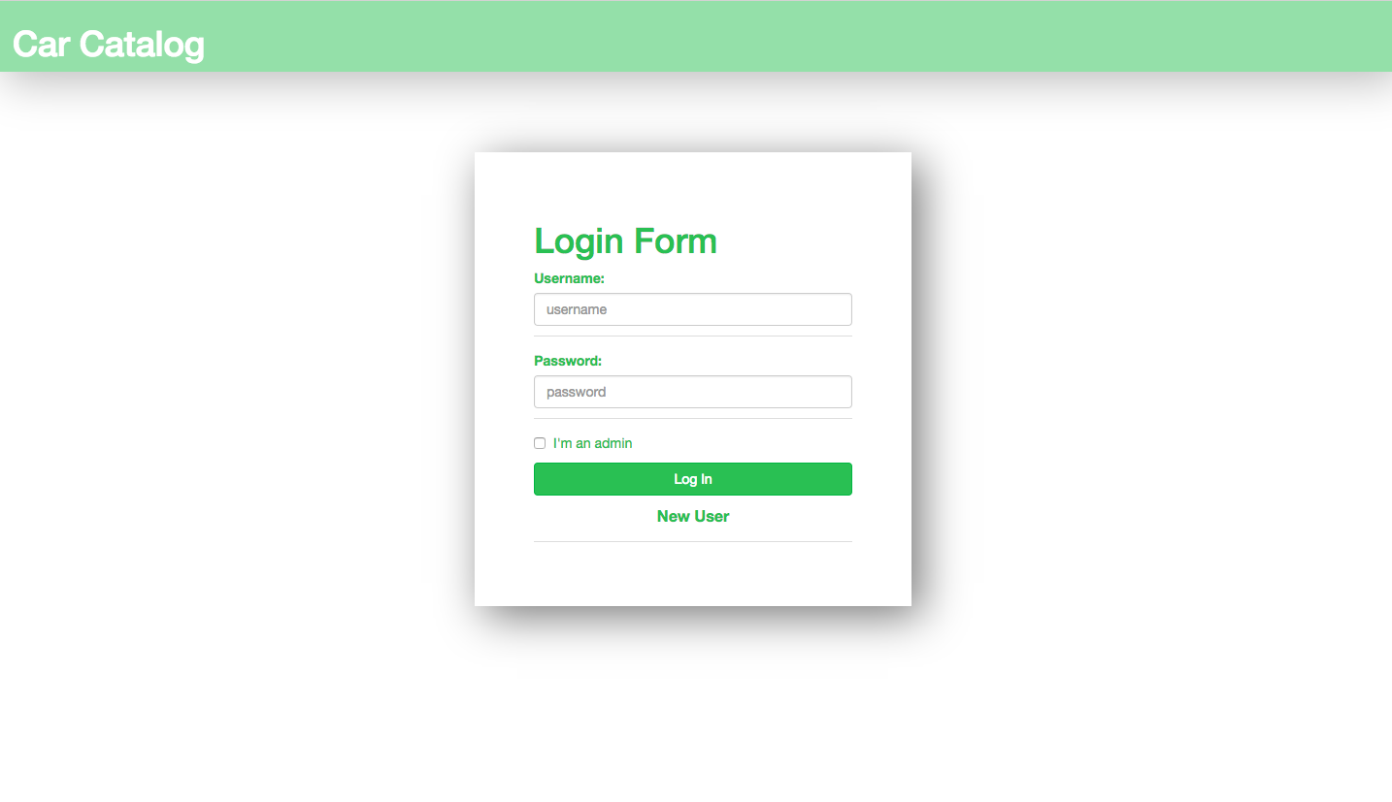
HOME PAGE

Slide 8
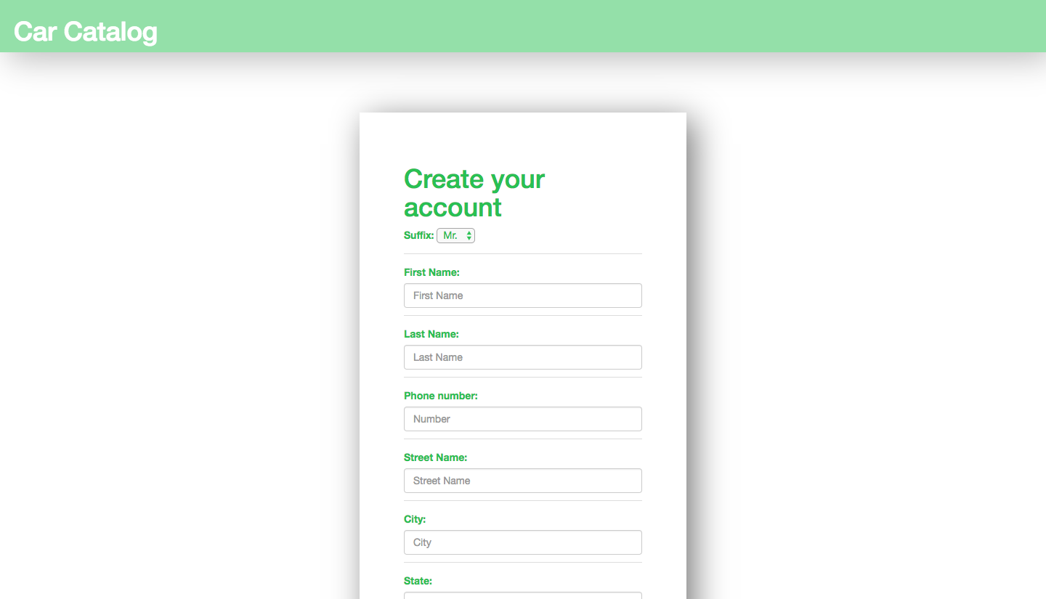
New User Login

Slide 9
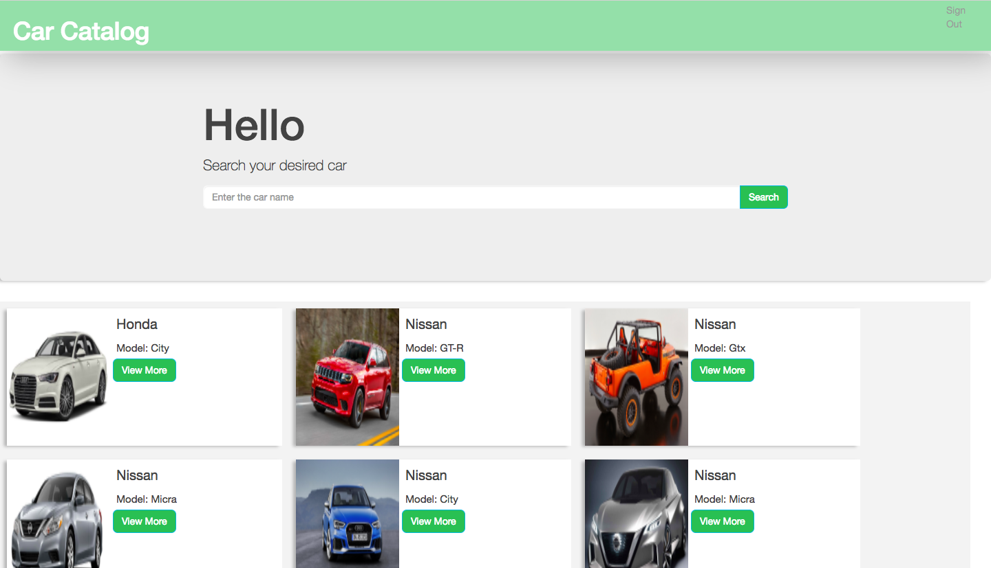
Catalog Search

Slide 10
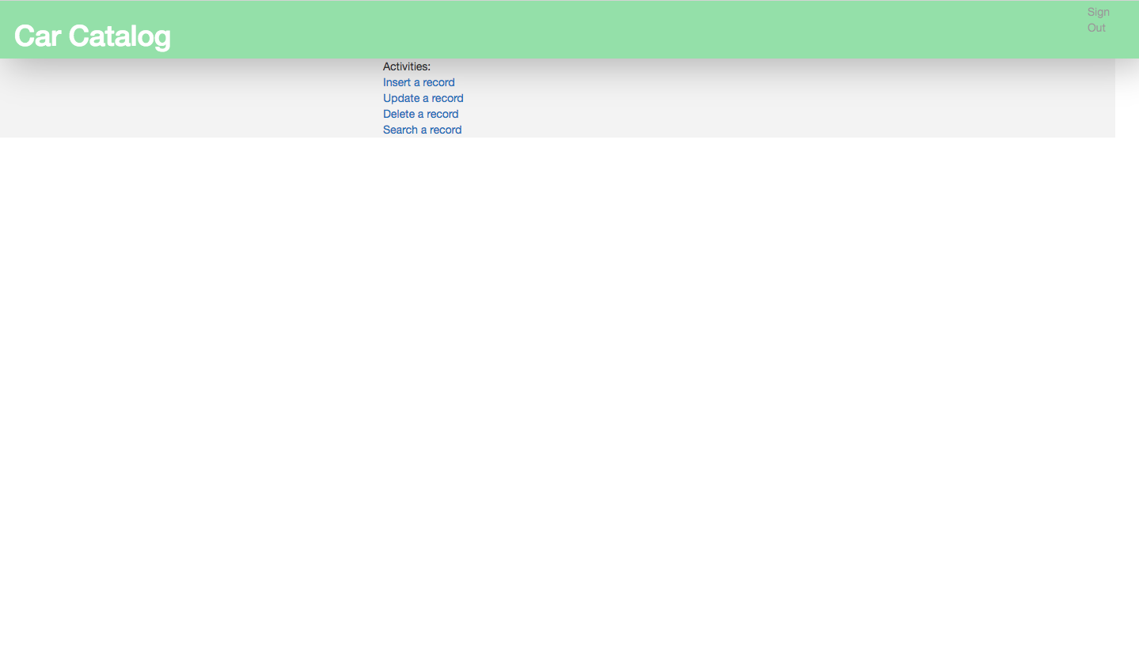
Admin Dashboard

Slide 11
Conclusion
Our website classifies 10 classes at the moment and more classes can be added into the website. Sky's the limit

Slide 12
THANK YOU FOR WATCHING!!!

